Slide 1
Clarks interview data task
Thursday 7th November, 2019
Dr Lorna Wilson
Wilson.Lorna@gmail.com

Slide 2
Outline of Presentation
Context
Dataset
Visualisation
Key Findings
Limitations
Recommendations
Further work

Slide 3
Context
Aim: To find opportunities to drive revenue growth based on information relating to customer purchasing.
I will present main findings here.
All my analysis (done using R) is available on github. The repository is private so I will need to add individual collaborators - email me for access.

Slide 4
Dataset
Cust id - unique identifier for a customer
Age – age of the customer
Credit score – customers credit score
Email – whether we have a customer’s email address
Distance to store – how far a customer lives from one their closest store
Online visits – number of online visits over a year period
Online transactions – number of online transactions over a year period
Online spend – amount of money a customer has spent over a year period
Store transactions – number of in store transactions made by a customer in a year period
Store spend – amount of money a customer has spent in store over a year period
Service satisfaction – satisfaction a customer has with our service [1 to 5]
Selection satisfaction – satisfaction a customer has with our product range [1 to 5]

Slide 5
Dataset
Cust id: unique identifier for a customer
Age: range 13-56
Credit score: range 504-941
Email: we have 30% of emails
Distance to store: median 7, range 0 to 1886 (no units!)
Online visits: median 7, range 0 to 1046
Online transactions: median 2, range 0 to 298
Online spend: median 40, range 0 to 6781
Store transactions: median 1, range 0 to 26
Store spend median: 30, range 0 to 1332
Service satisfaction: missing 34%
Selection satisfaction: missing 34%

Slide 6
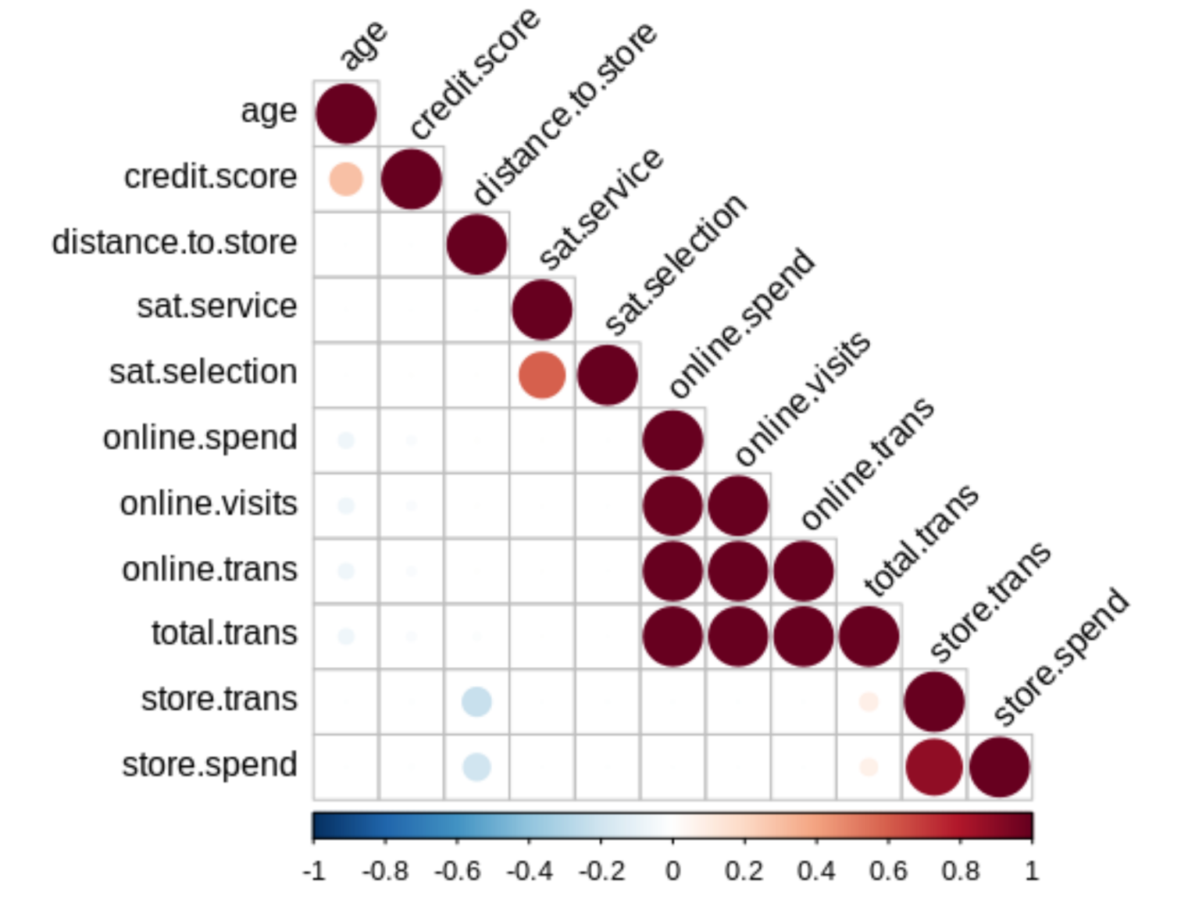
Visualisation – all correlations

Slide 7
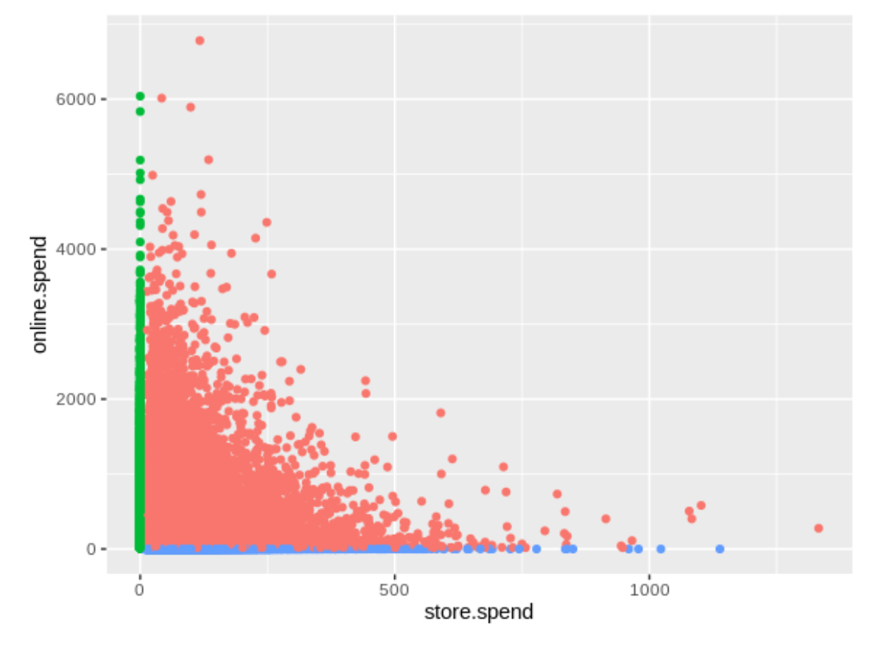
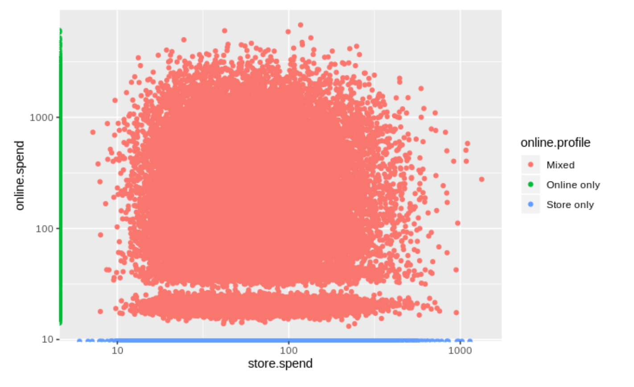
Visualisation – spending online vs in store
In store spending accounts for 20% of total spending
Pricing in store is more variable than online

Slide 8
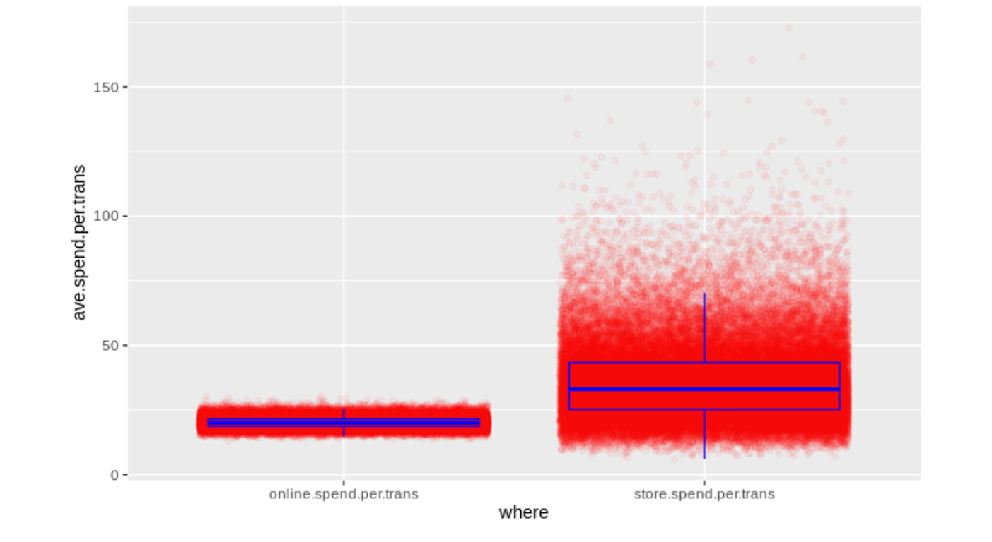
Visualisation – average spend per transaction
Online, people spend a lot less PER TRANSACTION and within a much smaller range.
Hypothesis for shoes - only buy one pair at a time.
Incentivise buy one get one 20% off as they go to checkout?

Slide 9
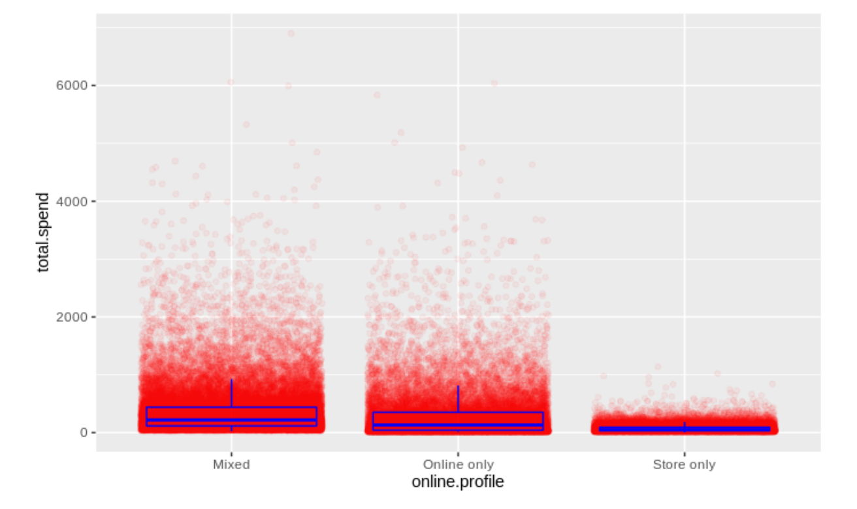
Visualisation – total spend
Store-only customers spend a lot less the whole year.
Can we get them to be returning customers, ideally online?
Offer with purchase e.g. for returning to store or online?
Collect email addresses in store – a competition to improve sharing?
Currently have approximately a quarter of store-only customers email addresses.

Slide 10
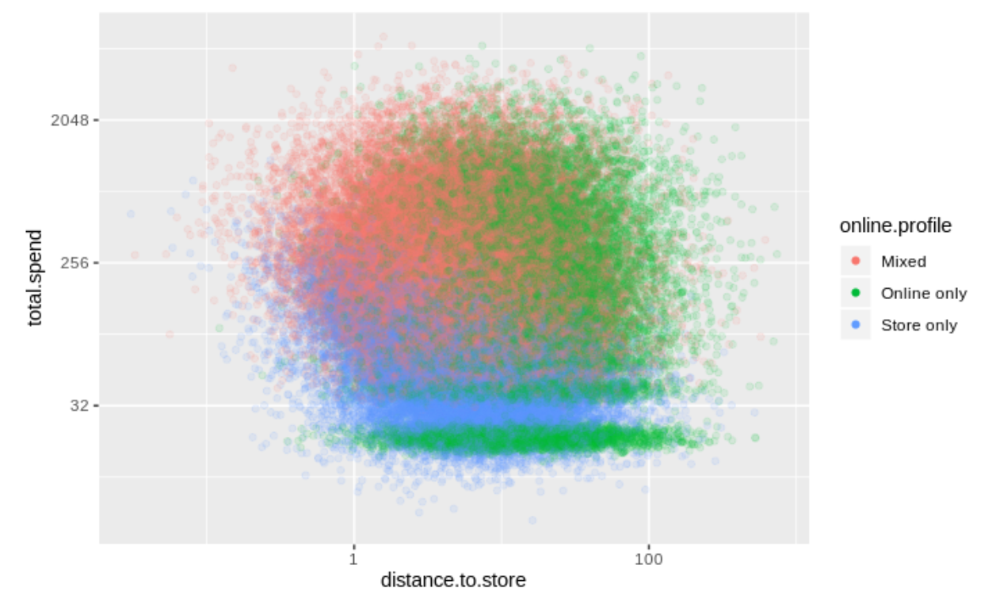
Visualisation – distance to store
As expected people who live further from store tend to shop online-only.
Store-only customers exist across distances but high spenders are local, further afield store-only customers are likely not returning. These could be targeted with offer for website.

Slide 11
Key Findings
Maximum age is low
We only have 30% of emails
Online, customers spend a lot less per transaction and within a much smaller range.
People who spend in store only spend a lot less overall across the year.
Store-only customers exist across distances but high spenders are local, further afield store-only customers are likely not returning.

Slide 12
Limitations
What about profit?
Relative cost of online and store based transitions?
No temporal data – how long is this period and when do different customer profiles make purchases (e.g. August for school, December for Christmas)
A lot of the data looks strangely symmetric – is this because it is simulated? Some results would raise my suspicions!

Slide 13
Recommendations
Maximum age is low – marketing campaign to target older shoppers this is a big demographic the ageing baby boomers should have money! Possible risk that this is off brand?
Online people spend a lot less per transaction and within a much smaller range - Incentivise buy one get one 20% off as they go to checkout?
We only have 30% of emails – Competition or similar to encourage sharing of email addresses?
People who spend in store only spend a lot less overall across the year – Include personal offer code on receipt for substantial discount with first online purchase to encourage these customers online?
Store-only customers exist across distances but high spenders are local, further afield store-only customers are likely not returning – As above, these customers could be worth targeting in particular.

Slide 14
Further work
Model the expected increase in revenue resulting from these recommendations – prioritise the recommendations.
Simple example: if half of store only customers became store and online customers and followed the same spending patterns this would lead to increase in revenue of 3225253 - a 14% increase in total revenue.
More sophisticated estimates with confidence intervals could be produced using monte carlo simulation, for example.
Develop strategy to collect data that will assess the results of any implemented recommendations.
Seek additional data either from in house or freely available external data e.g. there is data from ONS for textile clothing and footwear spending on the high street:
https://www.ons.gov.uk/businessindustryandtrade/retailindustry/articles/comparingbricksandmortarstoresalestoonlineretailsales/august2018

Slide 15
Further work
Carry out further analysis and modelling of data. For example:
Regression model to look at relative influence of different factors on total spend. Multilevel model could look at effect of region and store as well.
Clustering algorithm for customer segmentation which can help:
Determine appropriate product pricing
Develop customized marketing campaigns
Design an optimal distribution strategy
Choose specific product features for deployment
Prioritize new product development efforts.
Early stages example of a kmeans clustering algorithm is available in “Models.Rmd” on github (currently set to private – email me for access)

Slide 16
Recommendations
Maximum age is low – marketing campaign to target older shoppers this is a big demographic the ageing baby boomers should have money! Possible risk that this is off brand?
Online people spend a lot less per transaction and within a much smaller range - Incentivise buy one get one 20% off as they go to checkout?
We only have 30% of emails – Competition or similar to encourage sharing of email addresses?
People who spend in store only spend a lot less overall across the year – Include personal offer code on receipt for substantial discount with first online purchase to encourage these customers online?
Store-only customers exist across distances but high spenders are local, further afield store-only customers are likely not returning – As above, these customers could be worth targeting in particular.

